Slide 1
Technology Trends
Prepared by: Shafia Hussain

Slide 2
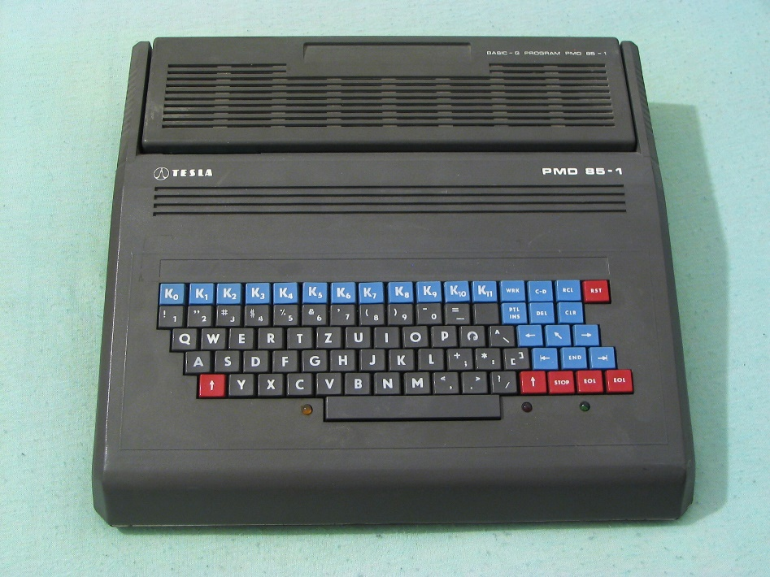
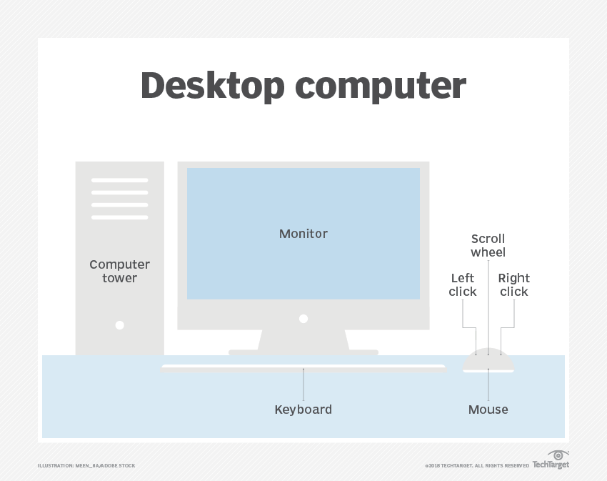
Types of Computers
PMD (Programming Mistake Detector)
Desktop Computers

Slide 3

Types of Computers
Servers:
File and computing services
Availability is critical. Server failure consequences are catastrophic.
Ability to scale up the computing capacity, memory, storage in response to increase in demand is critical
Throughput is important
Clusters/
Warehouse-scale computers (WSCs):
Collection of Desktop Computers or servers that act as a single computer. Large clusters are called WSC.
As a result of increased usage of software as service e.g search engine, social networking, video viewing
Similar to servers in terms of importance of availability in service, and failure causes huge losses for services such as online shopping
But different from servers in terms of scalability. Instead of adding components to a single machine, more machines can be added
majority of the cost of a warehouse is associated with power and cooling of the computers

Slide 4
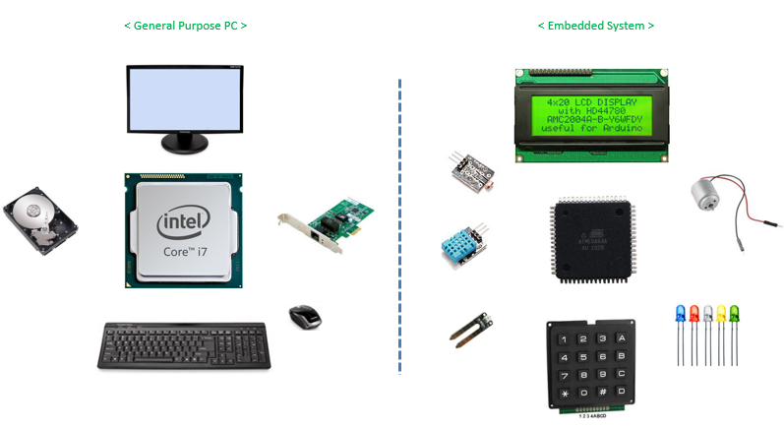
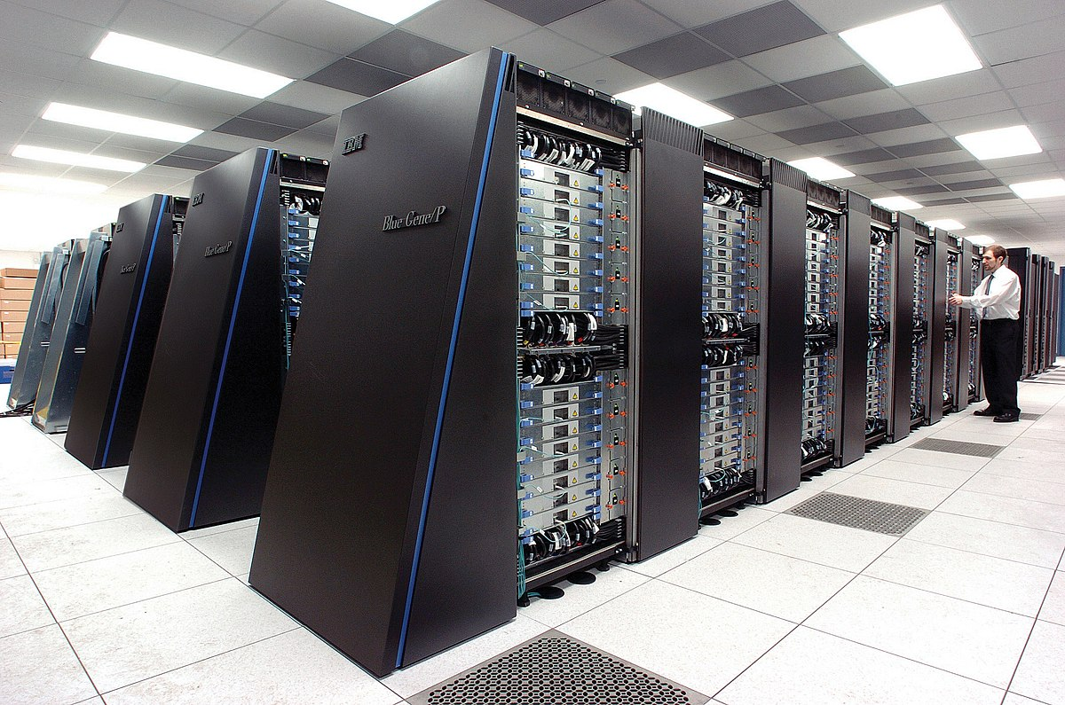
Types of Computers
Supercomputers:
Related to WSC but emphasize on performing computation intensive applications
Embedded Computers: Programmed for a specific task, e.g. Microwave oven controller, Biometric attendance monitoring system

Slide 5
Computer Architecture
Application
Algorithm
Programming Language
Operating System
Instruction Set Architecture
Microacrhitecture/Organization
Register Transfer Level
Gates
Circuits
Devices
Physics
This table gives the different layers upon which the final Application is built
Application
Requirements: Suggest how to improve architecture
Computer Architecture
Technology
Constraints: Restrict what can be done

Slide 6
Computer Architecture
Task:
Design a Computer to maximize performance and energy efficiency while staying within cost , power and availability constraints.

Slide 7
Computer Architecture
This task has many aspects
Instruction Set Design
Functional Organization
Logic Design
Implementation
Integrated circuit design : Multistage process to fabricate an electronic circuits, starting from a single slice of silicon
Packaging
Mounting the silicon circuit on a plastic base and connecting the tiny circuit inputs and outputs to externally accessible pins or pads with high quality bonding wires.
Power
Cooling
Decades ago Computer Architecture only referred to Instruction set design
But a designer must have knowledge of all the steps because the challenges in the other steps pose limits to the design

Slide 8
Instruction Set Architecture
Programmer visible instruction set
Different Dimensions of ISA
Class of ISA
General Purpose Register Architecture
Register-Memory ISA : 80x86
Load/Store ISA: ARM(Advanced RISC Machine), MIPS
Memory addressing:
All current architectures use byte addressing. Some require that objects must be aligned. An access to an object of size s bytes at byte address A is aligned if A mod s =0.

Slide 9
Different Dimensions of ISA
Addressing Modes:
How operands are specified in instruction. The difference is how memory is accessed.
For example in MIPS modes are register, immediate and displacement. 80x86 support these plus others with no register (absolute address), two registers.
Type and Size of operands:
Different ISA normally support these different size of operands .
8-bit (ASCII character), 16-bit (Unicode character or half word),
32-bit (integer or word), 64-bit (double word or long integer),
and IEEE 754 floating point in 32-bit (single precision) and 64-bit (double precision).

Slide 10
Different Dimensions of ISA
Operations: e.g data transfer, arithmetic/Logic, Control. RISC architecture has small/basic instructions while CISC can perform complex operation
Control Flow: All ISAs have control flow, i.e conditional and unconditional branches, procedure calls and returns. PC-relative addressing is normally used. MIPS conditional branches test the contents of a register while 80x86 and ARM test condition code bits (flags) that are set as a result of arithmetic/logic operations.
Encoding an ISA: Two choices available; fixed length or variable. Fixed length such as MIPS and ARM are easier to decode but take more space as compared to variable length e.g. 80x86 (1 to 18 bytes).

Slide 11
Technology Trends:
If an instruction set is to be successful, it must be designed to survive rapid changes in technology.
Integrated circuit logic technology:
Transistor density increases by about 35% per year. Increases in die size are less predictable and slower, ranging from 10% to 20% per year. The combined effect is a growth rate in transistor count on a chip of about 40% to 55% per year. This trend is popularly known as Moore’s law.
Semiconductor DRAM (dynamic random-access memory)
Capacity per DRAM chip has increased by about 25% to 40% per year recently, doubling roughly every two to three years.

Slide 12
Technology Trends
Semiconductor Flash
its rapidly increasing popularity has fueled its rapid growth rate in capacity. Capacity per Flash chip has increased by about 50% to 60% per year recently, doubling roughly every two years
Magnetic disk technology
Since 2004, it is increasing to about 40% per year, or doubled every three years. This technology is central to server and warehouse scale storage.

Slide 13
Performance Trends Bandwidth over Latency
Bandwidth:
Throughput: Work done in given time e.g bytes transferred per second
Latency:
Time between start and completion of an event e.g memory access.
Latency hasn’t improved (decreased) at the same rate as bandwidth is increased.

Slide 14
Performance Trends Transistor size shrink effect
Feature size: minimum size of transistor in x or y direction e.g 10 nanometer.
With decrease in feature size more transistors can be accommodated on chips & performance also increases
On the other hand decrease in wire width results in increase in resistance and capacitance per unit length; and signal delay for a wire increases in proportion to the product of its resistance and capacitance
Wire delay has become a major obstacle for large integrated circuits

Slide 15
Trends in Power and Energy in Integrated Circuits Three Concerns regarding Power
Peak Power:
if a processor draws more current than that a power supply is designed for, voltage will drop resulting in malfunction
Sustained Power Consumption (TDP):
The power consumption under maximum theoretical load. It determines the cooling requirement. If power exceeds TDP(thermal designed power), modern processors have two features
Decrease clock rate
If 1st doesn’t work then Thermal Overload Trip
Energy Efficiency: processor A may have a 20% higher average power consumption than processor B, but if A executes the task in only 70% of the time needed by B, its energy consumption will be 1.2 × 0.7 = 0.84, which is clearly better

Slide 16
Energy and Power within a Microprocessor (Dynamic Power)
The energy required per transistor for a pulse is proportional to the product of the capacitive load driven by the transistor and the square of the voltage:
The energy of a single transition (0→1 or 1→0) is then:
The capacitive load is a function of
number of transistors connected to an output (fanout),
the capacitance of the wires
The parasitic capacitance of transistor.(separation of mobile charges at various regions within the structure.)

Slide 17
Trends in Power and Energy in Integrated Circuits Energy and Power within a Microprocessor (Static Power)
Static power is also becoming an important issue because leakage current flows even when a transistor is off.
Thus increasing the number of transistors increases power even if they are idle, and leakage current increases in processors with smaller transistor sizes

Slide 18
Example
Some microprocessors today are designed to have (DVFS mechanism to) adjustable voltage, so a 15% reduction in voltage may result in a 15% reduction in frequency (since with reduction in voltage, available supply power is reduced). What would be the impact on dynamic energy and on dynamic power?

Slide 19
DVFS Dynamic Voltage and Frequency Scaling
Frequency is reduced dynamically according to the processing power.
Voltage is also reduced dynamically according to the frequency required.

Slide 20
Trends in Power and Energy in Integrated Circuits Growth in clock rate of microprocessors
15% increase/year from 1978 to 1986
40% increase/year from 1986 to 2003.
Since then only 2% /year.
Since all the power supplied is dissipated as heat, so cooling the chip is a major hurdle.
So after that there is a trend shift to add multi processors on a chip (called cores) instead of increasing clock rate.

Slide 21
Quantitative Principles of Computer Design
Trends in Power and Energy in Integrated Circuits Multiple Levels
System Level (multiple threads of softwares)
Processor Level (SIMD), pipelining
Digital design; Set Associative Cache, Carry Look Ahead
Principle of Locality
More true on code and less on data
Temporal and Spatial
Focus on Common Case:
In making a design trade-off, favor the frequent case over the infrequent case.
Focusing on the common case works for power as well. The instruction fetch and decode unit of a processor maybe used much more frequently than a multiplier

Slide 22
Defining Performance
How will you grade one computer better in performance than the other?
PCs and Embedded computers
Response Time
The time between the start and completion of a task. Includes disk access, memory access, I/O activities, operating system overhead, CPU execution time
Servers
Throughput( or Bandwidth)
Number of tasks completed per unit time.

Slide 23
Check Yourself
Do the following changes to a computer system increase throughput, decrease response time, or both?
Replacing the processor in a computer with a faster version.
Adding additional processors to a system that uses multiple processors for separate tasks—for example, searching the web

Slide 24

Performance (Response Time)
Performace = 1 / Execution Time
$\frac{PerformanceA }{PerformanceB}$ = $\frac{Execution TimeB }{Execution TimeA}$ = n
A is ‘n’ times Faster than B

Slide 25
User CPU Time
The response time a user experiences also includes time where OS is sharing CPU for other programs, and the waiting time for I/O.
CPU Execution Time is the time spent working only for the particular task.
CPU Execution Time
User CPU Time: Time Spent in the Program
System CPU Time: Time spent in operating system working on behalf of program, e.g display library, memory management (reading/writing from memory)

Slide 26

System Performance/CPU Performance
System Performance = $\frac{1}{\begin{aligned}Response Time(unload \\ ed Machine)\end{aligned}}$
CPU Performance(Our Focus) = $\frac{1}{User CPU Time}$
i.e Time only spent in program. Assume that any program in comparison also uses the same OS features, so that common part can be neglected.

Slide 27
Example 1
If computer A runs a program in 10 seconds and computer B runs the same program in 15 seconds, how much faster is A than B?

Slide 28
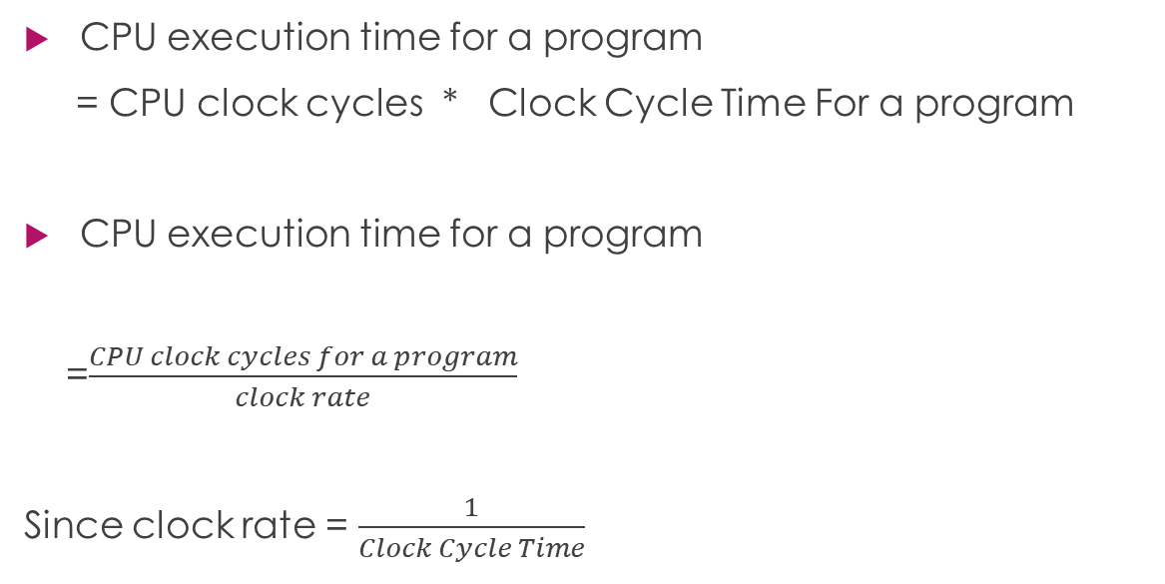
CPU Execution Time and Clock Cycle
CPU execution time for a program
= CPU clock cycles * Clock Cycle Time For a program
CPU execution time for a program
=$\frac{CPU clock cycles for a program}{clock rate}$
Since clock rate = $\frac{1}{Clock Cycle Time}$

Slide 29
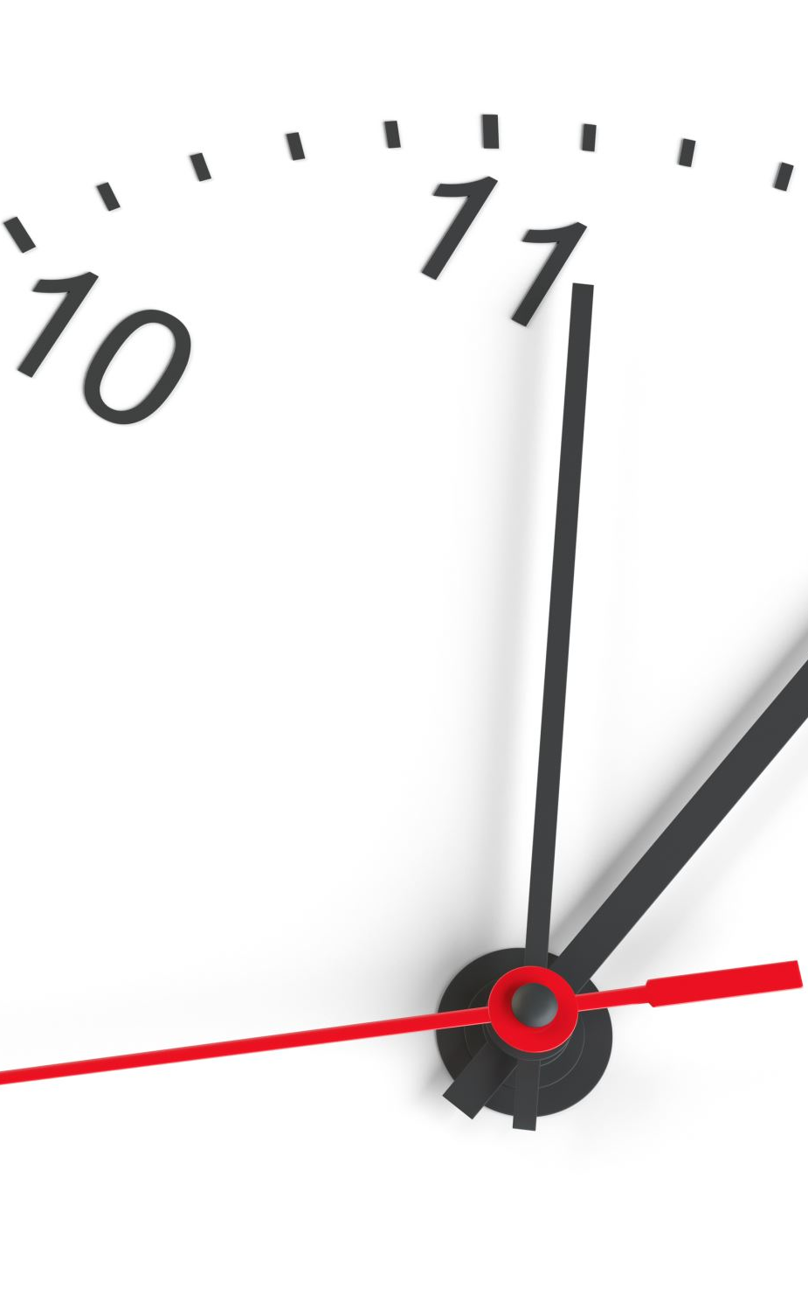
Improving Performance
Decrease clock cycle time
Or
Decreased no of clock cycles required by a program
Decreasing clock cycle time may increase no. of clock cycles required by a program and vice versa

Slide 30
Example 2
Our favorite program runs in 10 seconds on computer A, which has a 2 GHz clock. We are trying to help a computer designer build a computer, B, which will run this program in 6 seconds. The designer has determined that a substantial increase in the clock rate is possible, but this increase will affect the rest of the
CPU design, causing computer B to require 1.2 times as many clock cycles as computer A for this program. What clock rate should we tell the designer to target?

Slide 31
Solution
Exec time A = CCT * Clock cycles =Clock cycles/Freq
10 = Clock cycles/2G
Clock cycles A = 20G
Clock cycles B= 1.2 * 20G = 24G
Exec time B = Clock cycles/Freq
Freq = Clock cycles/6 = 24G/6 = 4GHz

Slide 32
Instruction Performance
Clock cycle per instruction abbreviated as CPI is the average no of clock cycles required by instruction since each instruction may take different no of clock cycles.

Slide 33
Example 3
Suppose we have two implementations of the same instruction set architecture. Computer A has a clock cycle time of 250 ps and a CPI of 2.0 for some program, and computer B has a clock cycle time of 500 ps and a CPI of 1.2 for the same program. Which computer is faster for this program and by how much ?

Slide 34
Solution
Assume that no. of instruction for both are same =I
Exec time A= CCT_{A} * (CPI_{A} * No of Instructions)
= 250 n * 2 * I= 500 n * I
Exec time B= CCT_{B} * (CPI * No of Instructions)
=500n * 1.2 * I = 600n * I
Performqnce A/ Performance B = 600n*I / 500n*I = 6/5
Although clock rate is double but performance is slightly better

Slide 35
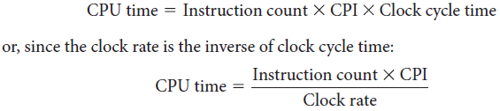
Classic CPU Performance Equation

Slide 36
CPU Performance Equation

Slide 37
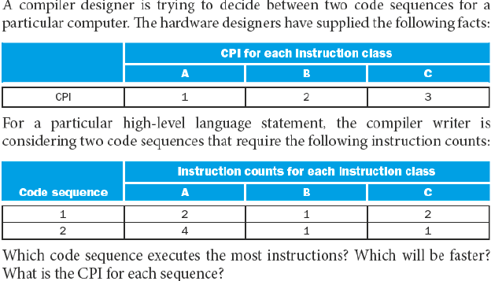
Example 4

Slide 38
Solution
Instruction count A= 2+1+2 =5
Instruction count B= 4+1+1 =6
c) CPI for each
CPI_{A} = (2*1 + 1*2 + 2*3) / 5 = 2
CPI_{B} = (4*1 + 1*2 + 1*3) / 6 = 9/6
b) Since Processor is same so CCT is same
Exec Time A = 5 * 2 *CCT = 10 clock cycles * CCT
Exec Time B = 6 * 9/6* CCT= 9 clock cycles * CCT

Slide 39
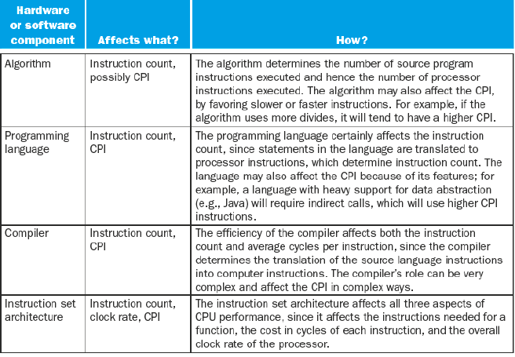
Factors Effecting performance

Slide 40
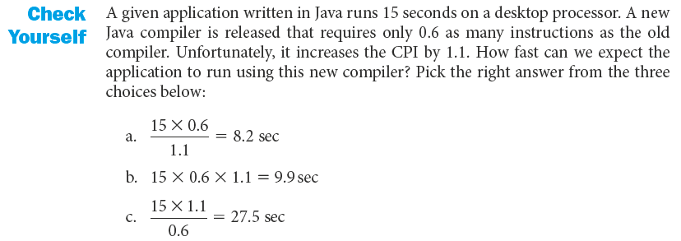
Check Yourself

Slide 41
Example

Slide 42
Original CPI
CPI_{orig} = 0.25*4+0.75*1.33 = 1.9975
Now we consider what improvement we get if FPSQR is improved which is 2% of the overall code. Since FPSQR is a part of total FP operations we need to calculate CPI of FP operations other than FPSQR
FPSQR = 2% of code
FP operations = 25% of code
So FPSQR percentage of total FP operations=(2/25) x 100 = 8%
Now 0.08* (20) +0.92 *x =4
gives x = 2.6087
It means CPI of FP operations other than FPSQR = 2.6087

Slide 43
So decreasing CPI of FPSQR to 2 will result in new CPI of FP operations
CPI_{new} of FP operations = 0.08* 2 + 0.92 * 2.6087 = 2.56
Decreasing CPI of all FP operations is giving
CPI_{new} of FP operations = 2.5

Slide 44
Amdahl’s Law
The performance improvement to be gained from using some faster mode of execution is limited by the fraction of the time the faster mode can be used.
Unaffected Execution time = Execution time_{old} - Execution time_{old} * Fraction_{enhanced}

Slide 45
Continued….
New Exec time for the fraction_{enhanced} = Execution time_{old} * Fraction_{enhanced} /Speedup
Execution Time _{new} = Unaffected Execution time + New Exec time for the fraction_{enhanced}
Fraction_{enhanced} is fraction of code affected by enhancement

Slide 46
Example

Slide 47

= ($\frac{1}{\left(1−0.4\right)+ \frac{0.4}{10}})$
=1 /( 0.6 + 0.04)
=1 / (0.64) = 1.56

Slide 48
Example

Slide 49

Improving square root
Floating point square root is 20% of of overall execution time.
Now applying Amdhal’s Law
($\frac{1}{\left(1−0.1\right)+ \frac{0.1}{10}})$
=1 /( 1-0.2 + 0.2/10)
=1 / (0.8 + 0.02 ) = 1.22

Slide 50
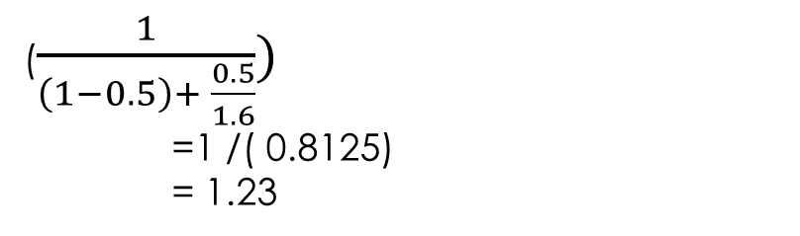
b) Improving all FP operation by a factor 1.6
($\frac{1}{\left(1−0.5\right)+ \frac{0.5}{1.6}})$
=1 /( 0.8125)
= 1.23
So we get more overall improvement in part b

Slide 51
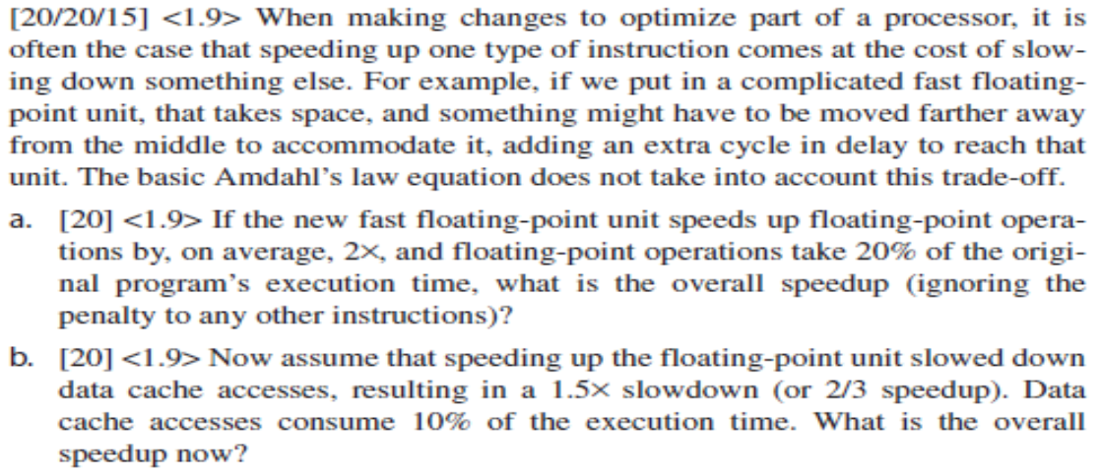

Example:

Slide 52
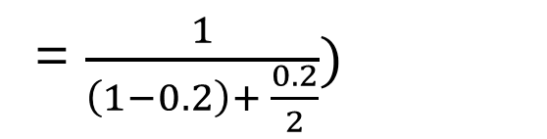
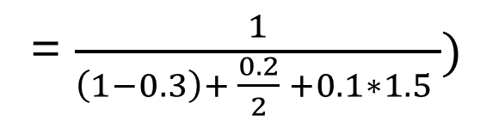
a)
b)
= $\frac{1}{\left(1−0.2\right)+ \frac{0.2}{2}})$
= 1.11
= $\frac{1}{\left(1−0.3\right)+ \frac{0.2}{2} +0.1∗1.5 })$
= 1.0526

Slide 53
Execution Time _{new} = Execution Time _{old} / Speedup _{Overall}
Assume Execution Time _{new} = x / 1.0526
Execution Time _{new} = 0.95 x
( i.e (0.7 + 0.1 + 0.15)x)
% of floating point = 0.1 x /0.95 x *100 = 10.53
% of data access 0.15x/0.95x *100 = 15.7

